Slide 1

SC1015
Mini Project
Predicting Churn in Telecommunications
Presented by:
Team 5 | A127
Loo Si Hui
Luyun Sean Gabriel De La Cruz
Nicole Kaira Almonte Imatong
Notes:
Hello, we are team 5 from tutorial group a127 and today we’ll like to present on our sc1015 mini project, Predicting Churn in Telecommunications.

Slide 2
Table of contents
01
02
03
04
05
Problem &
Goals
Exploratory
Dataset
Machine
Learning
Visualisation
Insights
Notes:
In our presentation, we will go through our problem and goals, exploratory data analysis, machine learning models we used, our data visualization, and finally conclude with the insights we gathered.

Slide 3
01
Problem & Goals

Slide 4
Churn in Telecom Industry
Revenue
Reputation
Customer Lifetime Value
Dataset: JB Link Telco Customer Churn from Kaggle
Notes:
Client churn, refers to the phenomenon where clients leave company’s service or switch to competitors.
Churn represents the loss of customers, *click*which has a direct impact on the revenue and *click* customer lifetime value. *click*Customers who churned away may share their negative-experiences which can harm the company’s reputation and make it harder to acquire new customers.
This is a significant and one of the top issues for big businesses and many companies are working to create methods to predict probable customer churn.
*click*Hence, our team has decided to dive into this topic using a telecommunition dataset from Kaggle.
(2min)

Slide 5
Churn in Telecom Industry
Use Machine Learning Methods to Predict Features Contributing to Customer Churn
Acquire Data Analytic Skills Applicable to Other Industries
Notes:
Through this project, we want to use various machine learning methods to predict features that contribute most to the customer churn with respect to the dataset we have selected. By gaining insight into the market and its customers through data analytics, we can acquire skills that are applicable to other industries as well.
(2min)

Slide 6
02
Explanatory Dataset
Data Cleaning & Initial Insights

Slide 7
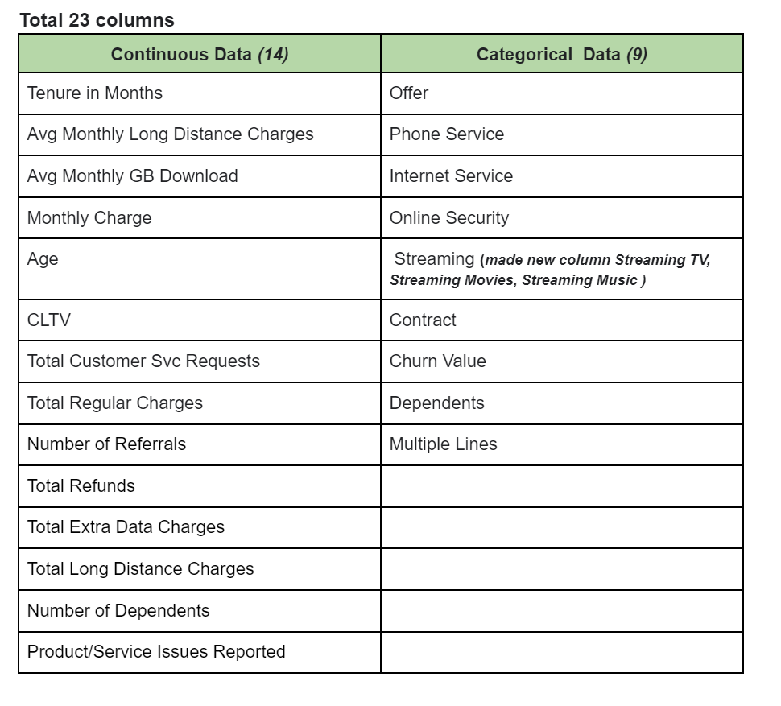
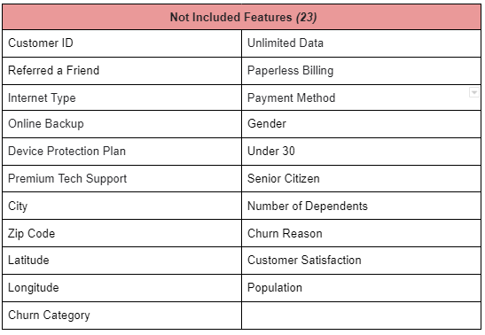
Data Preprocessing
Notes:
In our dataset, we have found that not all data would be relevant to our prediction, hence we have shortlisted the dataset from 46 cols to 23 cols, and also classified the 23 columns into Continuous or Categorical Data.

Slide 8
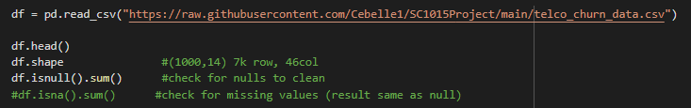
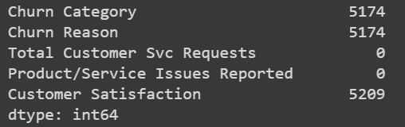
Data Cleaning
Code Snippet:
Snippet of Number of Nulls:
Notes:
While cleaning our data, we dropped the columns of “Churn Category” *click*, “Churn Reason”*click*, and “Customer Satisfaction”*click* as they have a lot of null values that are irreplaceable.
We also dropped columns that might be repetitive, such as “Referred a Friend”, which meant the same as “Number of Referrals”.

Slide 9
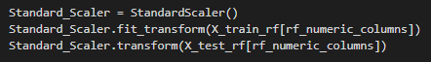
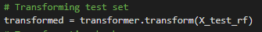
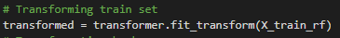
Data Normalization & Encoding
Normalizing Technique:
Encoding Categorical Data:
Notes:
We have used a StandardScaler from sklearn to put the columns of different scales on a comparable scale.
*click* We have also encoded categorical data before feeding it into the models.

Slide 10
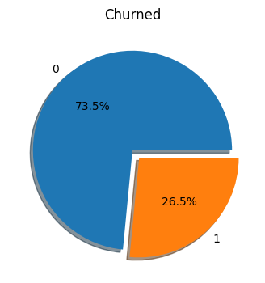
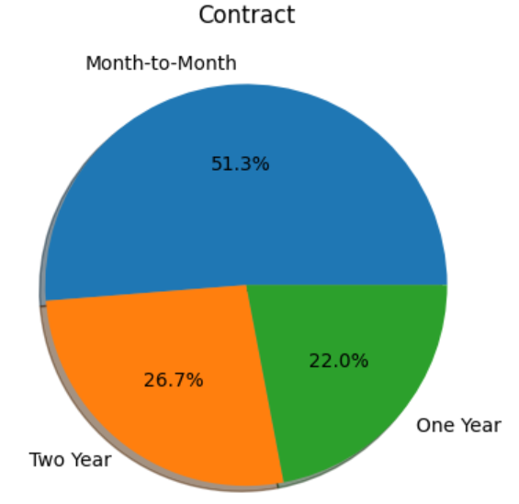
Initial Overview
Notes:
Our main goal is to identify issues related to churn. An average churn rate for a telecom company is 22%, which ours is higher by a bit, at 26.5%.
*click*
Another issue that caught our attention is that most customers rely on short-term contracts, as opposed to long-term ones. Short term contracts are undesirable as the lack of commitment makes it easier for customers to switch providers. There is also a lack of predictability for future revenue streams and reduced opportunities for cross-selling and up-selling of other products.
Hence, these two initial insights provides us with a direction for issues we can look into.

Slide 11
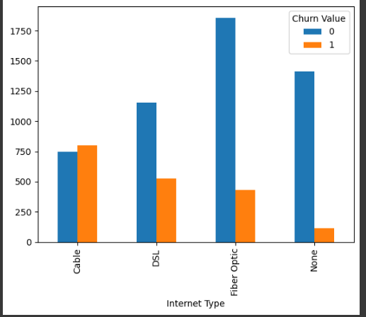
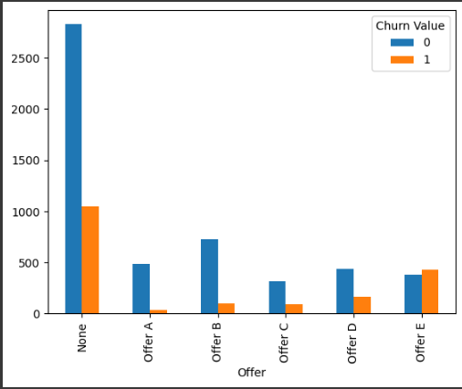
Initial Overview
Notes:
Other insights that caught our attention would be the high churn proportion in Cable Internet Type, and Offer E. The company can further investigate issues with these options.

Slide 12
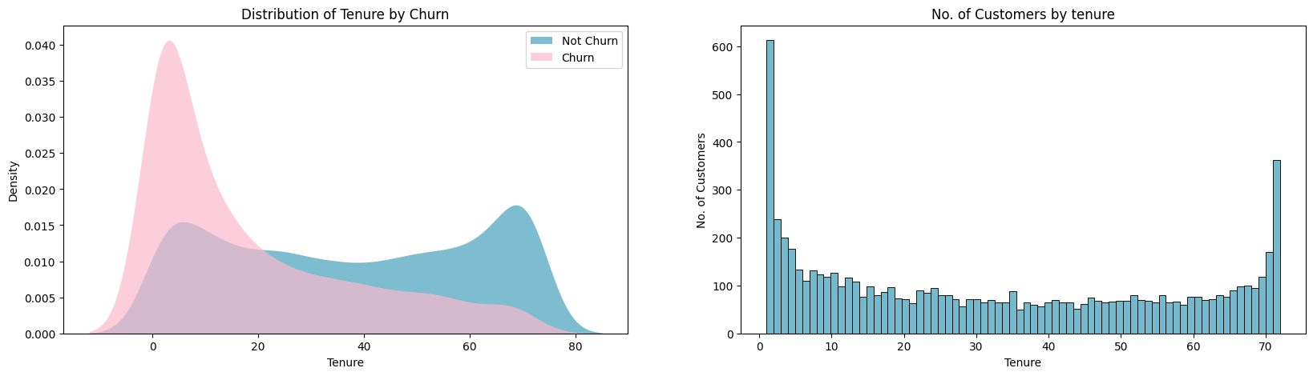
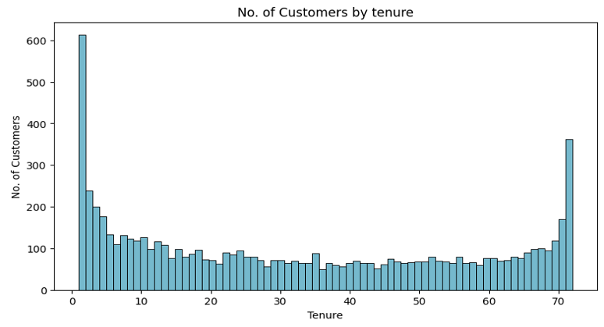
Notes:
In our Tenure vs Chun plot, we discovered that customers with lower tenure have a higher tendency to churn, *click* where many customers churn just after 1 month.

Slide 13
Notes:
As highlighted, where many customers churn just after 1 month.

Slide 14
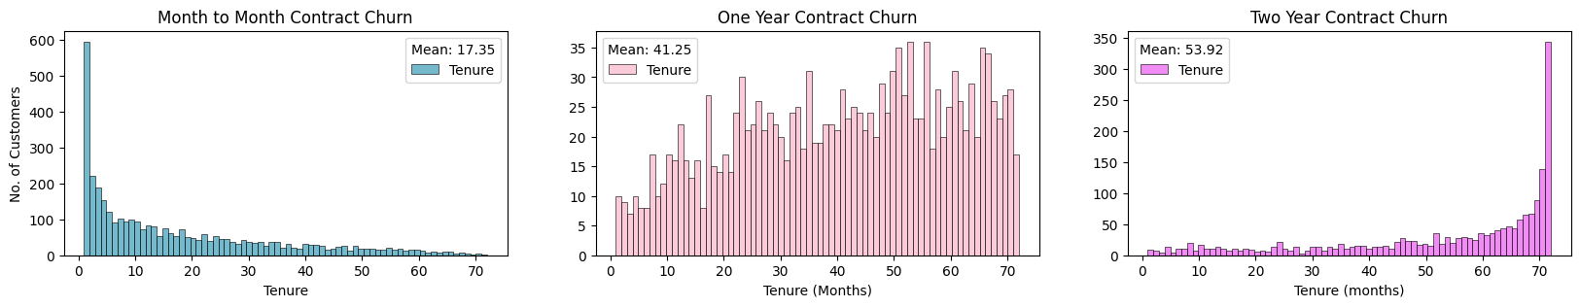
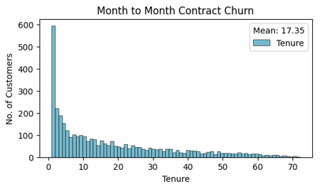
Notes:
Diving deeper, we found that the churn in shorter tenure lies mainly in the month-to-month contract.

Slide 15
Notes:
This insight links back to our initial overview, where the identified problems are apparently closely related.

Slide 16
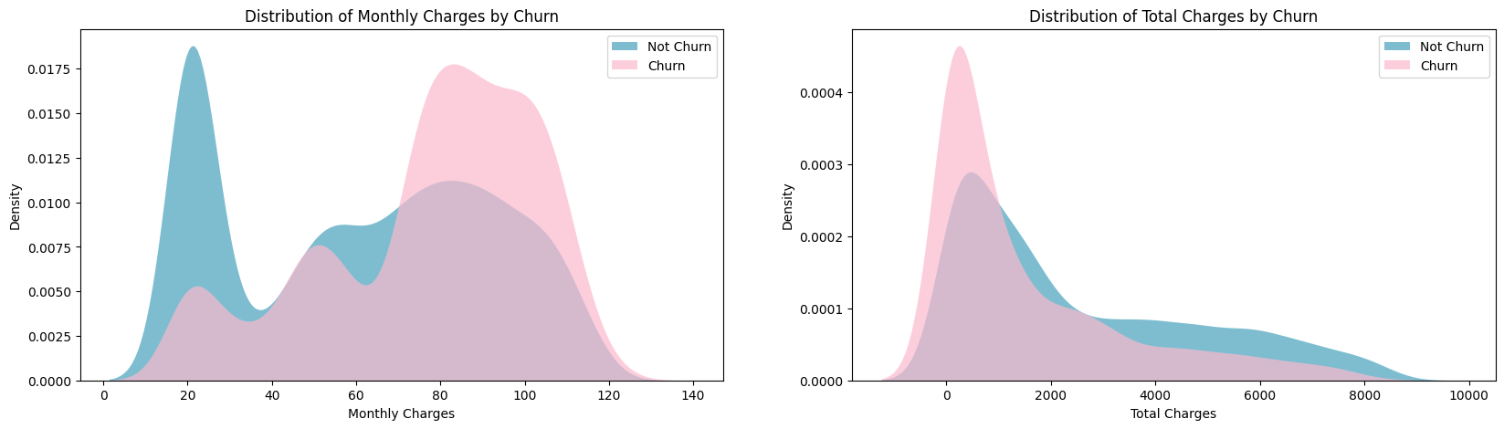
Notes:
We also saw the trend in those with higher monthly charges having a higher tendency to churn.

Slide 17
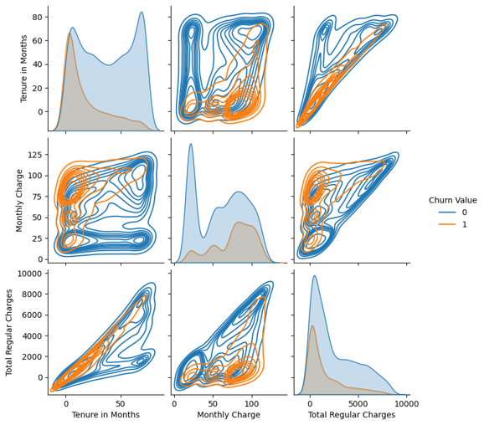
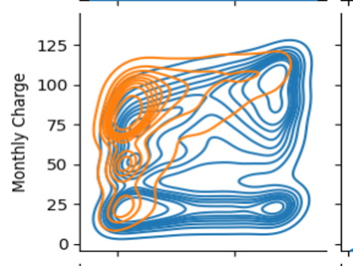
Notes:
We plotted a pairplot to see the relations of tenure, charges, and churn value.

Slide 18
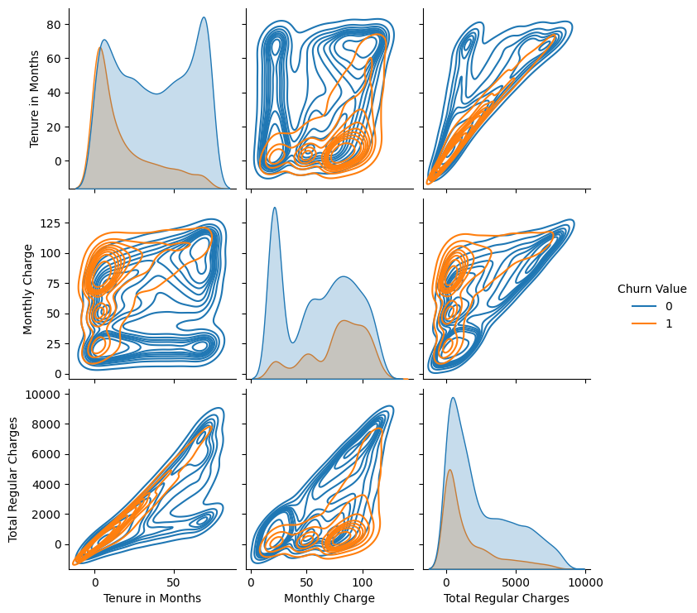
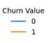
0
50
Tenure in Months
Notes:
Diving deeper, we see that churn is also related to the tenure, where from the middle left graph *click*, customers with lower tenure but higher monthly charges tend to churn.

Slide 19
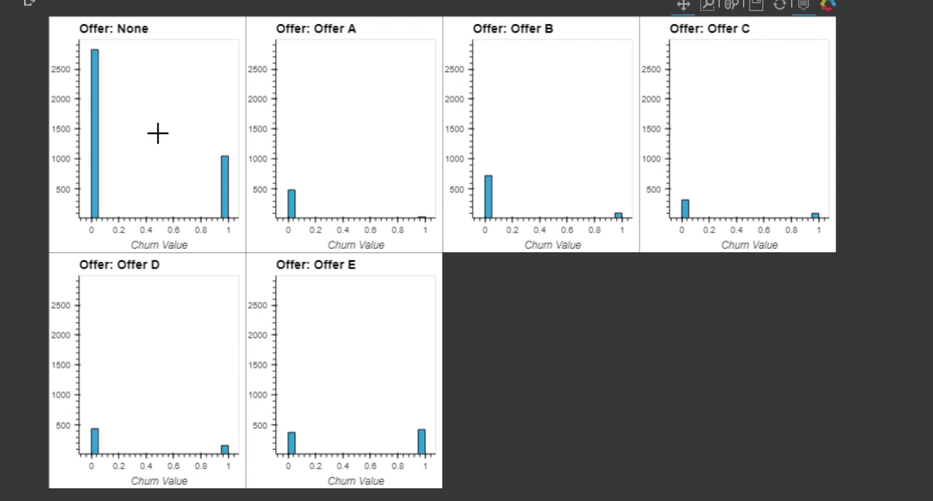
Interactive Plots
Notes:
It is worth mentioning that, other than seaborn and matplotlib, our team had also plotted interactive plots using holoview, but for presentation purposes we did not show them in this video.

Slide 20
03
Machine Learning
Notes:
To further analyze our data, we have employed the usage of machine learning models. Machine learning can help us uncover complex patterns within our data to identify the most important features that contribute to the prediction of our response variable (Which, in this case, is the churn value).

Slide 21
Using Machine Learning
Notes:
Before we start using our machine learning models, we would like to elaborate on the method we used to split our train and test datasets. From our pie chart, we can see that the values are imbalanced as the number of people who did not churn is much higher than the number of people who did.

Slide 22
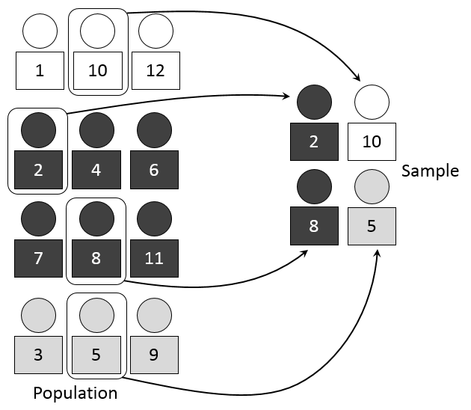
Stratified Sampling
Notes:
Thus, we would like to employ stratified testing. Stratified testing allows us to split our subsets with a fairer distribution. In our case, since the distribution is about 73 to 26, for each test and train subset that we generate, the ratio between not churned and churned will be around 73:26. Additionally, we have incorporated k-fold cross validations as well, where our dataset has been split into 5 different folds. Each of these folds will be trained and tested against each other, potentially giving us better accuracy when using our machine learning models.
https://en.wikipedia.org/wiki/Stratified_sampling#/media/File:Stratified_sampling.PNG

Slide 23
Using Machine Learning
Notes:
Next, we have also seen that our churn value ranges from either 0 or 1. Thus, we wish to use machine learning models that are best suited in predicting or classifying boolean responses.

Slide 24
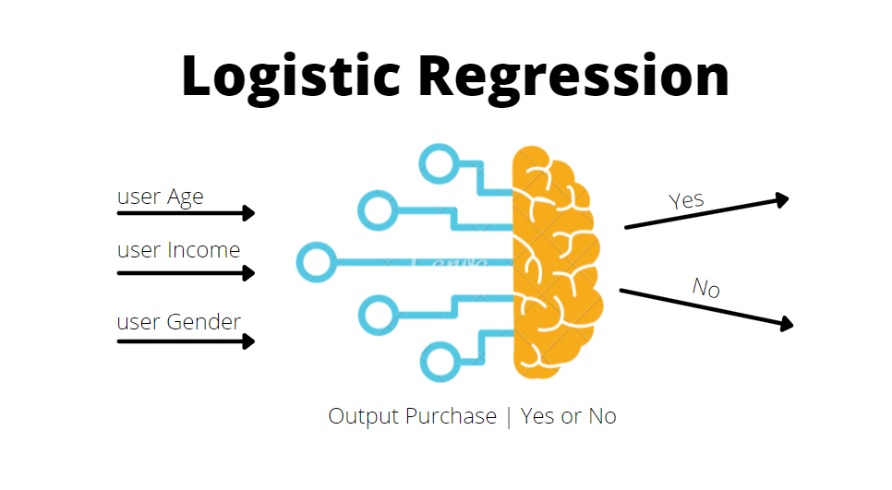
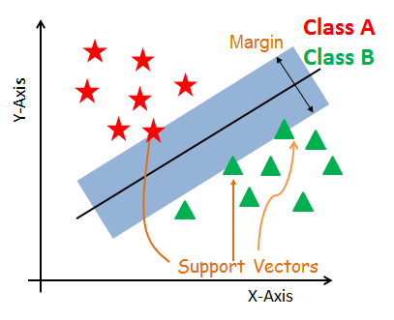
Using Machine Learning
Notes:
We have decided on the following models, which include Logistic Regression, Support Vector Machines,

Slide 25

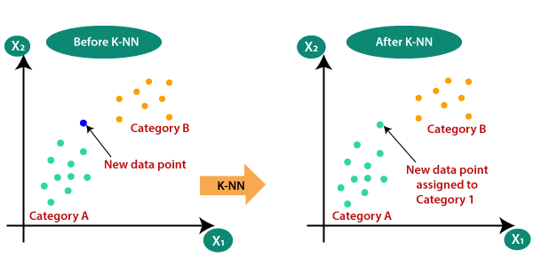
Using Machine Learning
Notes:
K-nearest neighbors, Random Forest Classification, and Extreme Gradient Boosting. All these machine learning models ultimately use the predictor variables to try to categorise the response variable. In this case, they predict whether the customer churns or not. While all of the models ultimately give predictions, they use different methods in classifying the data, hence some models may result in more accurate predictions than others.

Slide 26
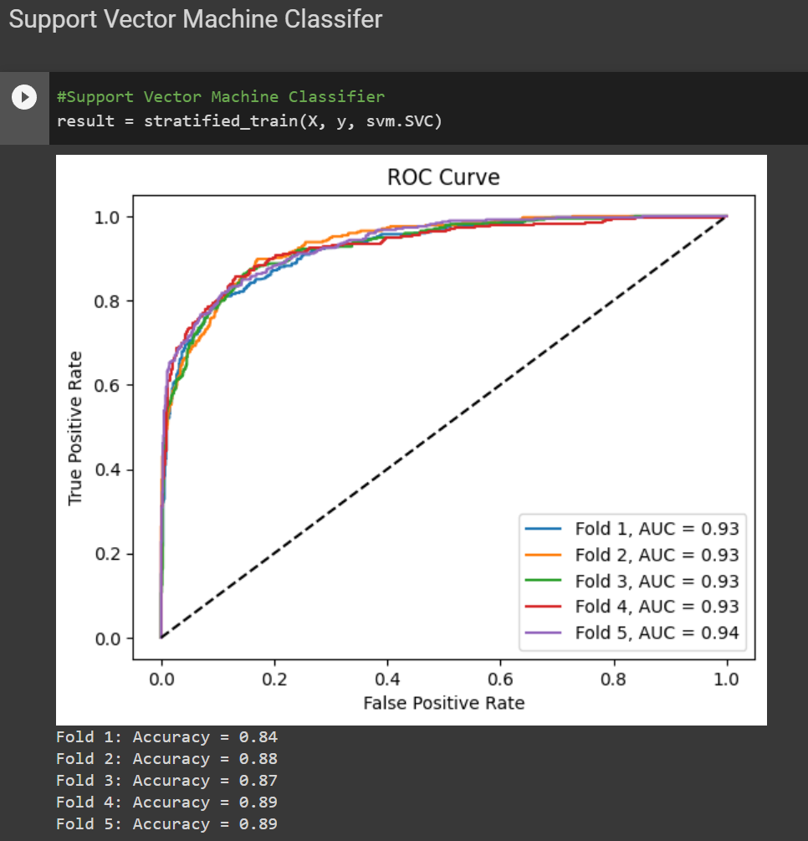
Results
Notes:
To test the accuracy of our models, we have plotted out the Receiver Operating Characteristic curve (or ROC for short) along with the Area under the curve (or AUC). The AUC determines the percentage of correct predictions the model has made. In general, the higher the AUC, the better it is at predicting the response variable. We have also used the accuracy score metric from scikitlearn, which works using similar principles, and the higher the accuracy score, the better. Here are the results for our Support Vector Machine,

Slide 27
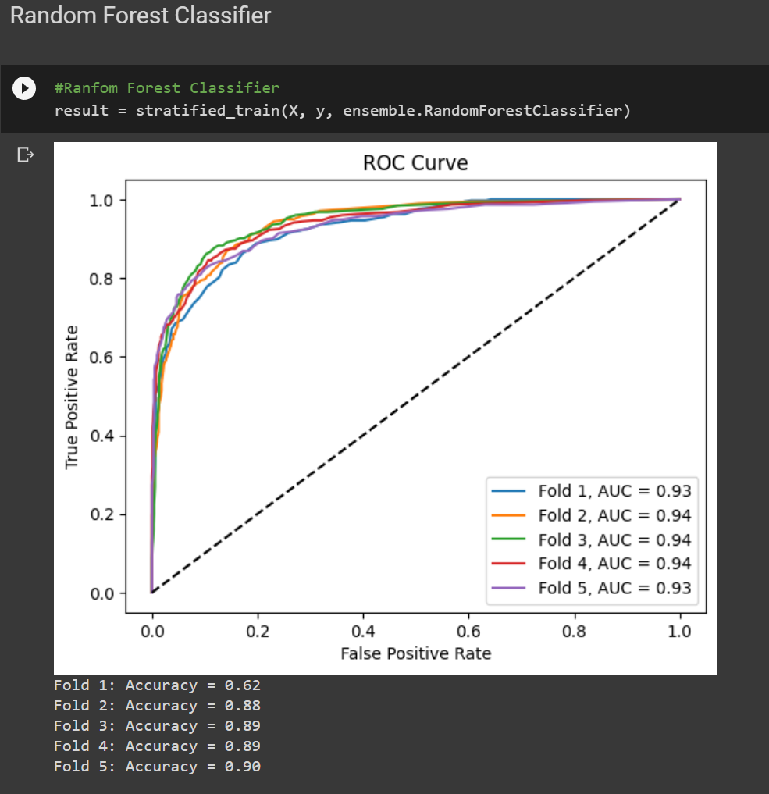
Results
Notes:
Random Forest Classifier,

Slide 28
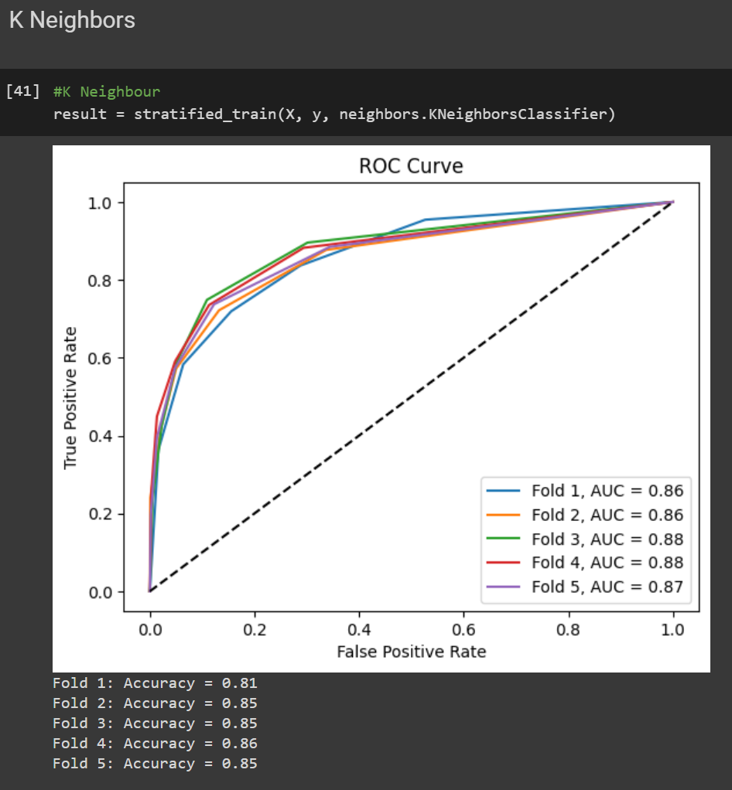
Results
Notes:
K-nearest neighbors,

Slide 29
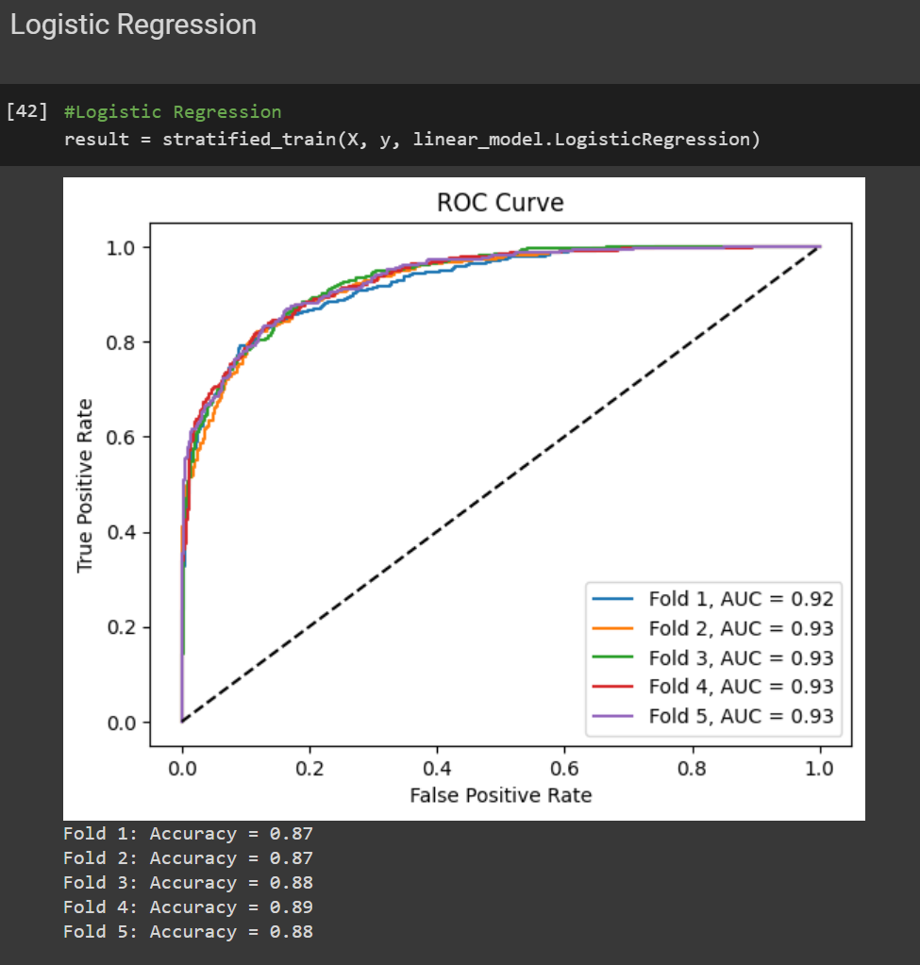
Results
Notes:
Logistic Regression,

Slide 30
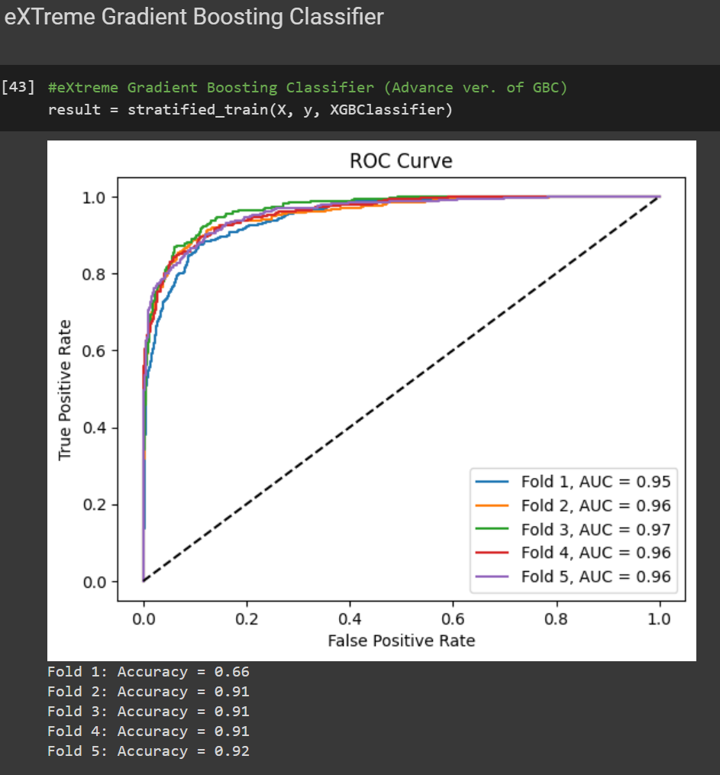
Results
Notes:
And Extreme Gradient Boost. From our results, we have found that the models with the highest AUC and accuracy score on average are the Random Forest Classifier and Extreme Gradient Boost models. Thus, we wish to continue forward using these models in particular, so that we may get the best results and most accurate outcomes from our given data.

Slide 31
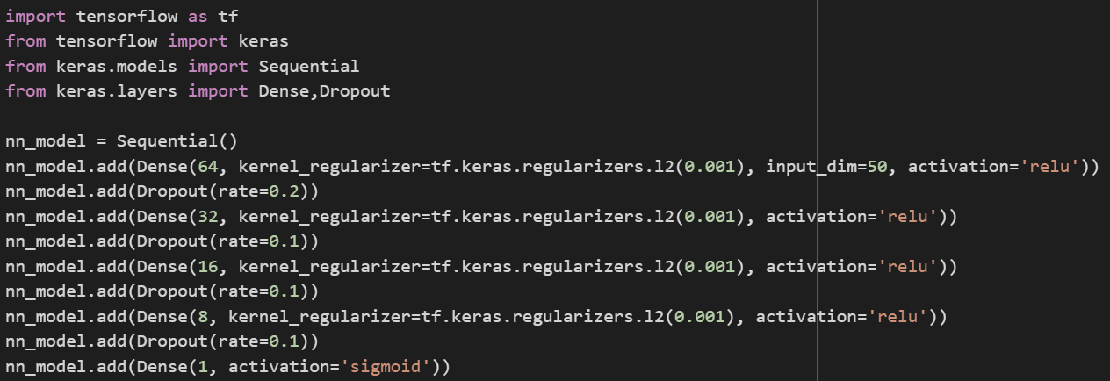
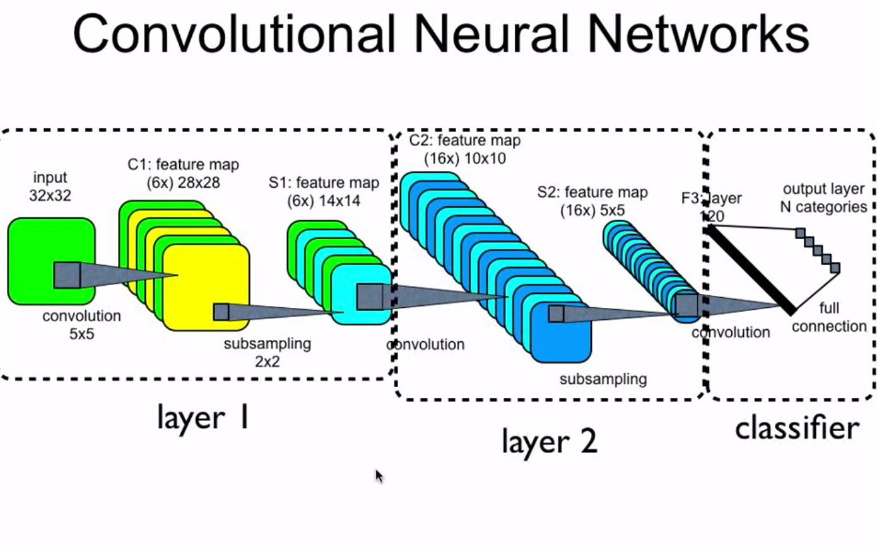
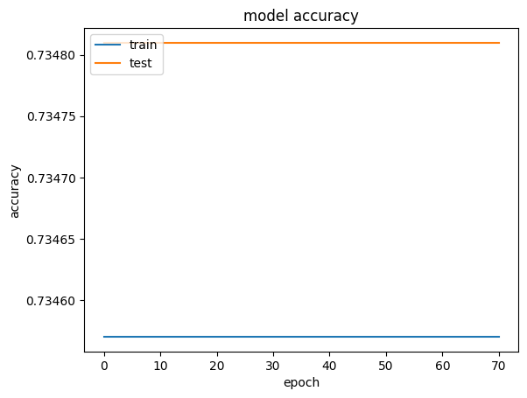
Using Deep Learning
Notes:
Before we move on, we would also like to quickly mention that although we tried to explore deep learning by building our own model, the training output shows no improvements and the accuracy does not look promising. This could be due to the complexity of tuning the hyperparameters. Hence, we have decided to drop this model from further evaluation.

Slide 32
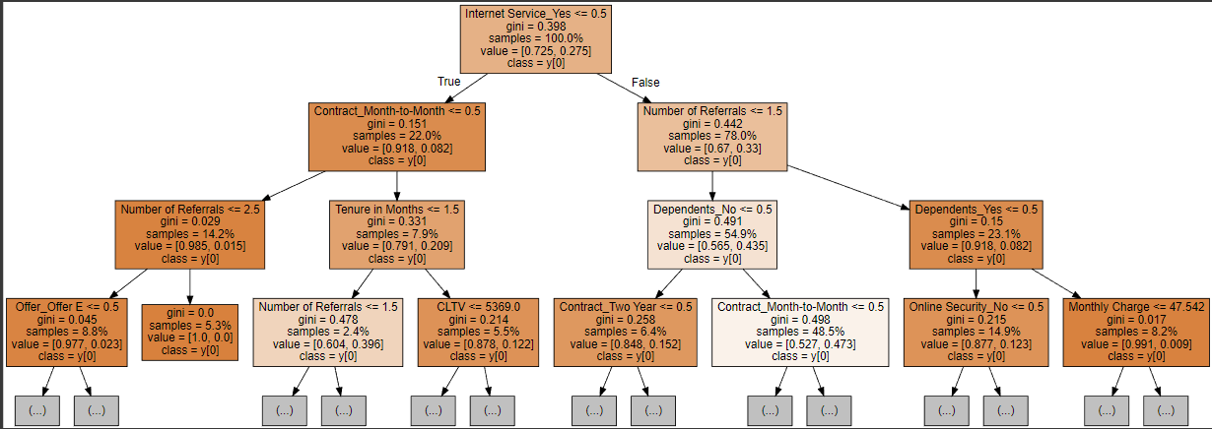
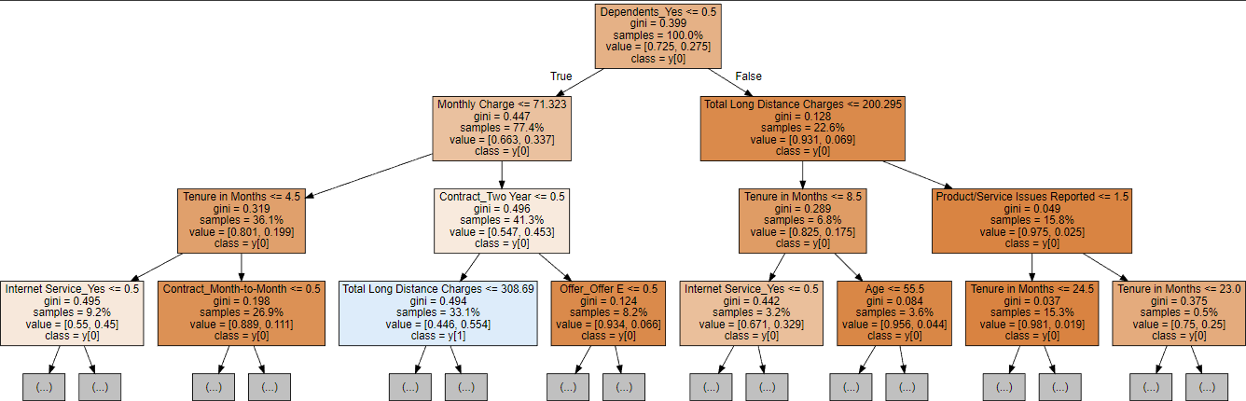
Random Forest Classifier
Notes:
With that being said, we narrow it down to the Random forest classifier and extreme gradient boost models due to its high accuracy. For Random forest classifier, here are 2 out of the 10 tree we plotted (que)

Slide 33
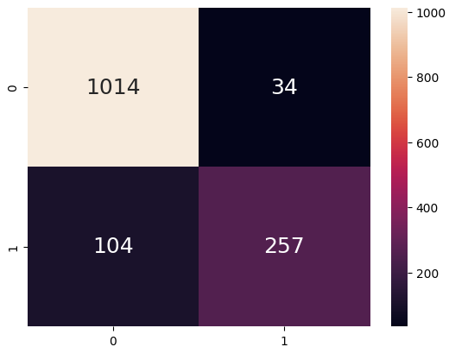
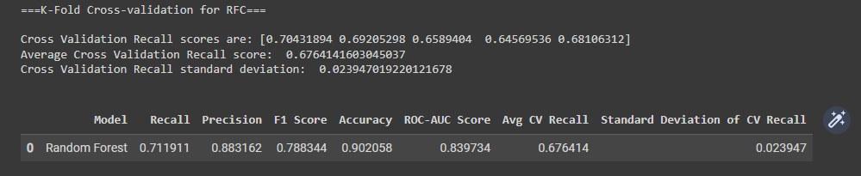
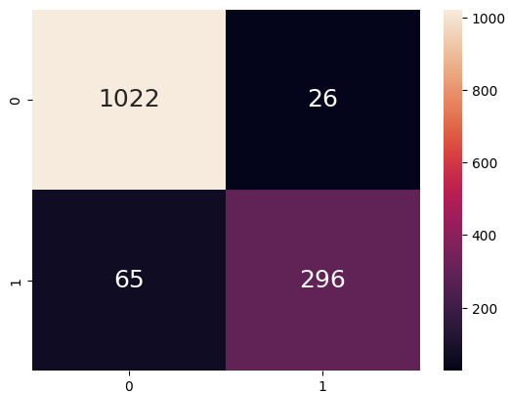
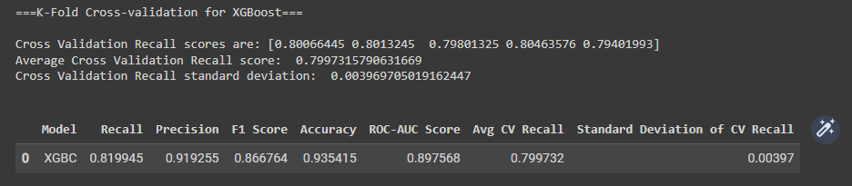
Random Forest Classifier (K-fold)
XGBoost models (K-fold)
Notes:
Now, let’s compare the Random Forest Classifier and the extreme gradient boost model using the K Fold Cross-Validation results below. (que)
It appears that the extreme gradient Boost model outperforms the Random Forest classifier model in all metrics. (que)The extreme gradient Boost model has higher recall, precision, F1 score, accuracy, and average CV recall. Additionally, the XGBoost model has a smaller standard deviation of CV recall (que), suggesting that it may be more stable and less sensitive to changes in the training data.
Overall, it seems like the (que) extreme gradient Boost model is a better choice for this churn prediction problem.

Slide 34
04
Visualisations
Notes:
Now let's take a look at the outcome of our project.

Slide 35
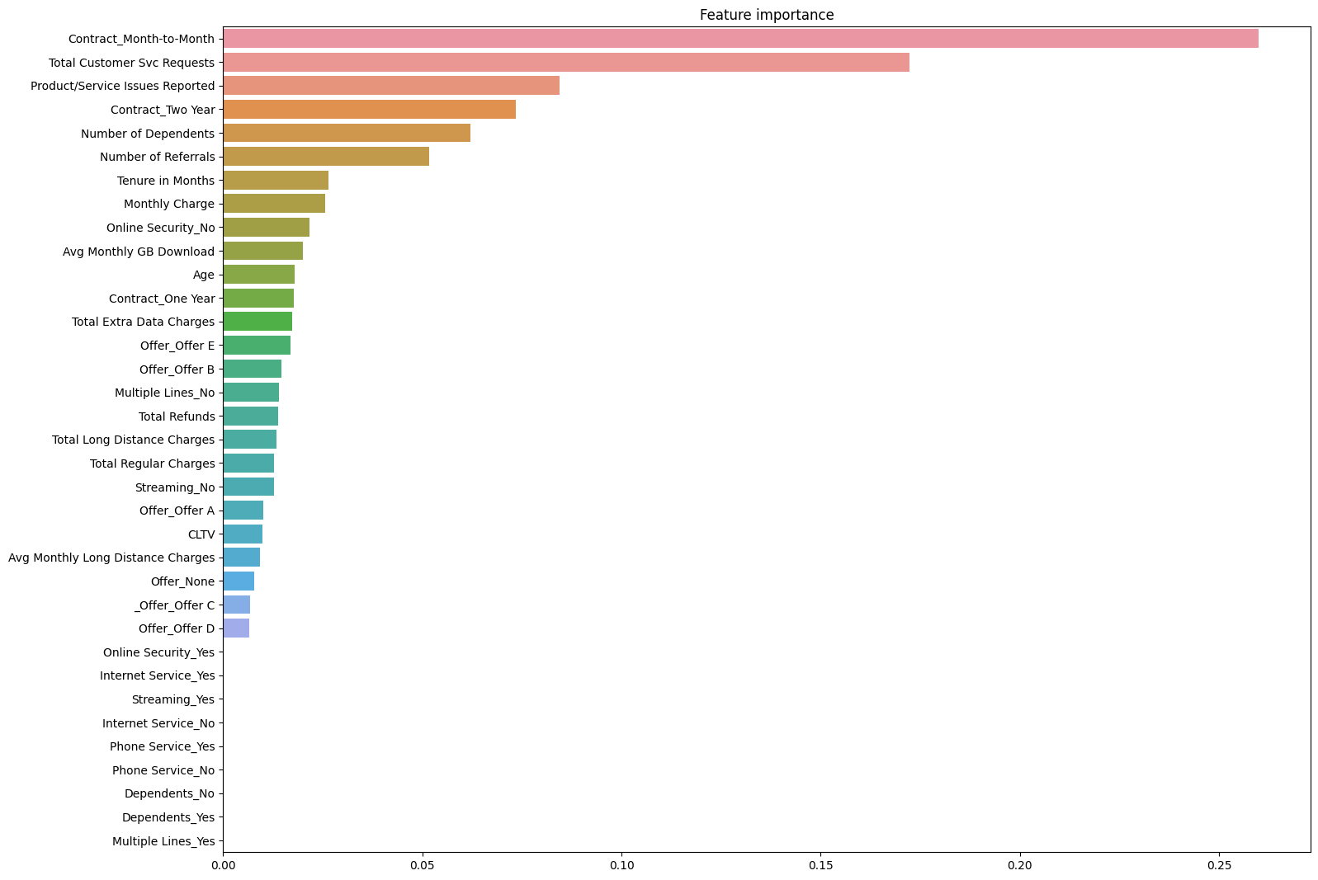
Further Analysis & Feature engineering
Notes:
Here we have a bar graph with shows the most important and least important features for our model.
They are namely (que) contact Month-to-month, Total customers svc request and product/service issues reported.
Whereas the features (que) below online_securtity onwards are the features that does not affect churn predictions.
With this, we are able to understand which features are most relevant to the churn predictions.
Moreover, (que) we can look into these features for further analysis or feature engineering
Through the data science process, Our team collaborated and explored various data science techniques, including machine learning and deep learning. We successfully implemented different models and found that the exteme gradient Boost model was the top performer for churn prediction.

Slide 36
05
Insights
Notes:
Now, for our data driven insights and recommendations for the company

Slide 37
Data Driven insights
Customers with Lower Tenure tends to Churn
Customers on Month-to-Month Contract are made up of mainly Customers with Lower Tenure
Customers with Lower Tenure have relatively Higher Monthly Charges
Notes:
(que)Firstly, it was evident that customers with lower tenure are the ones who tend to Churn.
(que)Secondly, Customers on Month-to-Month Contract are made up of mainly Customers with Lower Tenure.
(que)Lastly, customers with lower tenure have relatively higher monthly charges.
Therefore, these is what we can conclude. (que)

Slide 38



Insights
Customers loyalty depends on first few months of company service + lack of positive experience
Customers on Month-to-Month Contract feels less committed to the company
Pricing of services by the
company may be too expensive
for Customers
Notes:
Firstly, the customer’s loyalty to the company depends on the first few month. The lack of positive experiences with the company service may lead them to leave
Next, month-to-month contracts may lead to less commitment and higher likelihood of switching to a competitor.
Lastly, customers may be sensitive to pricing and may be more likely to switch to a competitor if they feel they are not getting a good value for their money.

Slide 39


Recommendations
Encourage longer contracts to customers
Improve/maintain on customer services
Notes:
To address this issue, the company could consider offering incentives to customers, such as discounts or promotions, to encourage them to stay with the company.
Another recommendation, would be to consider offering longer-term contracts with lower monthly charges to provide customers with more stability and incentivize them to remain loyal to the company.

Slide 40
Thank you!
Presented by:
Team 5 | A127
Loo Si Hui
Luyun Sean Gabriel De La Cruz
Nicole Kaira Almonte Imatong
Notes:
With that we come to the end of out video. Thank you!

Slide 41
Reference
Slide 38: https://www.freepik.com/premium-photo/10-percent-off-promotion_1335846.htm
Slide 38: https://truckstop.com/blog/factoring-agreement/
Slide 24: https://blog.devgenius.io/develop-a-logistic-regression-machine-learning-model-64d2be403ba3
Slide 24: https://www.javatpoint.com/k-nearest-neighbor-algorithm-for-machine-learning
Slide 25: https://en.wikipedia.org/wiki/Random_forest
Slide 25: https://www.datacamp.com/tutorial/svm-classification-scikit-learn-python
Slide 31: https://stats.stackexchange.com/questions/128880/number-of-feature-maps-in-convolutional-neural-networks

